Slide 1


Play by Play Series on Azure WebJobs
Integration SharePoint Online Process with Web jobs
-By basant Pandey

Slide 2

Topics
Introduction with Web Jobs?
Setup Environment
Configure Web Jobs
Demo : Write First Test Program
Integration with SharePoint Online using PNP PowerShell Modules
Automate Site Creation Process
Extra : Trigger Web jobs with Flow

Slide 3
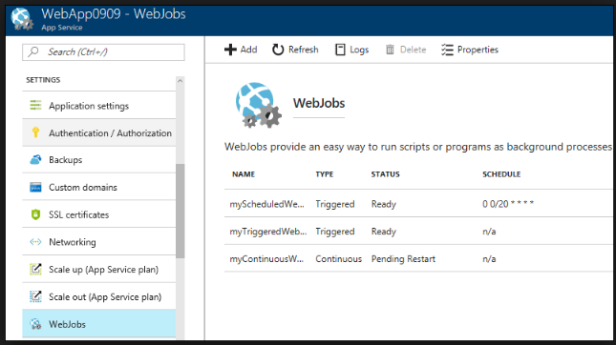
Introduction with Web Jobs
Provide the ability to run the background task.
Web Jobs Types
Continues
Start immediately, when job created.
Run On All the Instance (Load balancing). You also restrict to run in the single instance
Support remote debugging
Triggered
Start only when triggered manually or on schedule.
Runs on single instance
Doesn’t support the remove debugging
Supported file types
.cmd, .bat , .exe , .ps1 (poweshell, .sh (Bash), .Php(Php), .py (Python), .js( Node.js) and .jar(Java)

Slide 4
Introduction with Web Jobs Continue…
Develop Web jobs
https://docs.microsoft.com/en-us/azure/app-service/websites-dotnet-deploy-webjobs
https://docs.microsoft.com/en-us/azure/app-service/webjobs-sdk-get-started
https://docs.microsoft.com/en-us/azure/app-service/webjobs-sdk-how-to

Slide 5

Demo

Slide 6
Setup Environment
Microsoft Azure Premium license or Visual Studio subscription (https://azure.microsoft.com/en-in/free/search/?&OCID=AID719810_SEM_hi1rUtwt&gclid=CjwKCAjwrNjcBRA3EiwAIIOvq0AM9dOeRVC7EX1TMH3lm1Jo4DKgHX898j7JRELgy4SABds4kTmn2hoCBUYQAvD_BwE&dclid=CN_cqMewsN0CFRAYjgodXHIArQ )
Visual Studio Code https://code.visualstudio.com/
Add PowerShell Extension https://marketplace.visualstudio.com/items?itemName=ms-vscode.PowerShell
For SharePoint Integration, install (https://github.com/SharePoint/pnp-powershell/releases )

Slide 7
Setup Environment Continue…..

Slide 8
Configure Web Jobs
Add Web Jobs
Setup type of Jobs
Continues
Manual
Triggered
CRON

Slide 9
Configure Web Jobs continue..

Slide 10
Write First Test Program
Read Web Application Setting values from inside the Azure WebJobs.
How to use the PNP SharePoint PowerShell Dlls
Download the dependency in local using Save-Module command.
Include the reference in project
Read the site Info from PNP SharePoint PowerShell Dllls.

Slide 11
Write First Test Program Continue….

Slide 12
Integration with SharePoint Online using PNP PowerShell Modules
Connect to the Site Via App Authentication
Register a SharePoint app
_layouts/15/AppRegNew.aspx
Add permissions to the registered app
http://tenent-admin.sharepoint.com/_layouts/15/AppInv.aspx
Permission XML
<AppPermissionRequests AllowAppOnlyPolicy="true">
<AppPermissionRequest Scope="http://sharepoint/content/tenant" Right="FullControl" />
<AppPermissionRequest Scope="http://sharepoint/social/tenant" Right="Read" />
<AppPermissionRequest Scope="http://sharepoint/taxonomy " Right="Read" />
</AppPermissionRequests>

Slide 13
Integration with SharePoint Online using PNP PowerShell Modules Continue …..

Slide 14
Automate Site Creation Process
Create the custom list “New site Creation Request” and fields
Create Flow to read list data “New Site Creation Request” and send email and update the list values.
Add Site Creation Request and via web job every 2 Min. read the values from the list and update the status.

Slide 15
Automate Site Creation Process

Slide 16
Extra: Trigger Web Jobs using Flow

